Slide 1

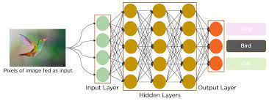
Image Caption Generator with CNN and LSTM
Prepared By : 20BCS1868, 20BCS2907,
20BCS1646
Project Teacher Project Supervisor:
Jyoti Bala Mam
.DISCOVER . LEARN . EMPOWER

Slide 2

Project Need
Makes us to know the knowledge of software building.
Learn knew things and programming implementation in python
Using different libraries in python.
A software for the public purpose to make the customers enjoy.
It’s Generate the caption of any image.
Learning new concepts and to develop the software.

Slide 3

Project Objectives
Image Caption Generator with CNN – About the Python based Project
The objective of our project is to learn the concepts of a CNN and LSTM model and build a working model of Image caption generator by implementing CNN with LSTM.
In this Python project, we will be implementing the caption generator using CNN (Convolutional Neural Networks) and LSTM (Long short-term memory). The image features will be extracted from Exception which is a CNN model trained on the ImageNet dataset and then we feed the features into the LSTM model which will be responsible for generating the image captions.

Slide 4

Individual Contribution
Coding
Two members of the group are required to work on the coding sections by learning the concepts of the programming language used in this project .
GUI
Another rest member of the group will work on the report work.

Slide 5
Introduction To Project
Image Caption Generator is simple generate a caption of image.
In this We give the URL of any image and it simply generate the caption of image.
You’ll learn how to convert values to different data types, and why you would need to do this.
Making this software we will use of various software, and hardware materials.
This is a software based project which will be made by group of students and it will be developed on the basis of project report and distribution of students.

Slide 6
Methodology Used
Explaining methodology using flowchart and Algorithm
Algorithm

Slide 7
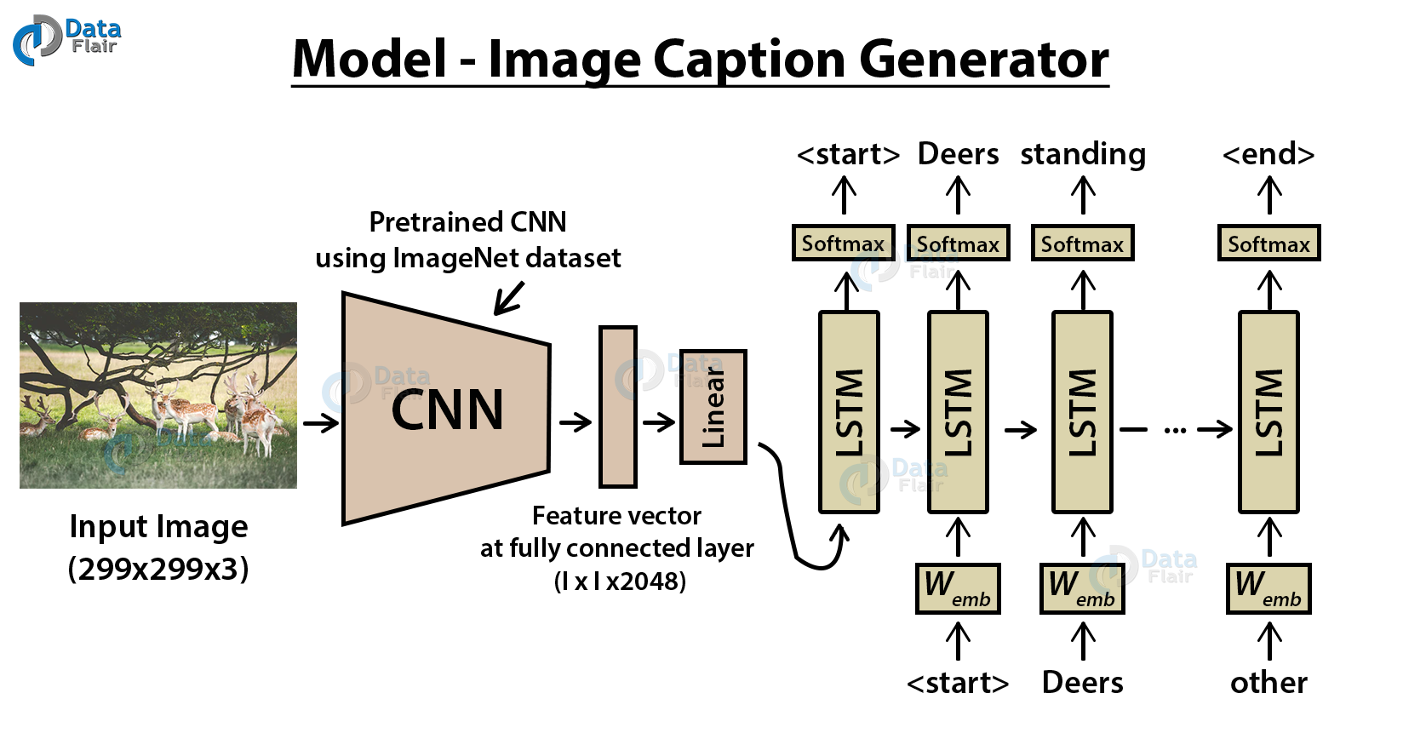

Slide 8

Platforms/Technology/Languages Used
Hardware
Pendrive:- This hardware is required to save the program files and to store them at one place . A USB flash drive is a data storage device that includes flash memory with an integrated USB interface. It is typically removable, rewritable and much smaller than an optical disc. Most weigh less than 30 g.
System Requirement:- In computer science and information science, system is a Hardware system, software system, or combination, which has components as its structure and observable inter-process communications as its behavior. System requirement is a major requirement which needs to make this software .

Slide 9
Software
Visual Studio Code
Visual Studio Code is a lightweight but powerful source code editor which runs on your desktop and is available for Windows, macOS and Linux. It comes with built-in support for JavaScript, TypeScript and Node.js and has a rich ecosystem of extensions for other languages (such as C++, C#, Java, Python, PHP, Go) and runtimes (such as .NET and Unity).
Python
Python is a general-purpose coding language—which means that, unlike HTML, CSS, and JavaScript, it can be used for other types of programming and software development besides web development. That includes back end development, software development, data science and writing system scripts among other things.
VGG-16
VGG-16 is a convolutional neural network that is 16 layers deep. You can load a pretrained version of the network trained on more than a million images from the ImageNet database [1]. The pretrained network can classify images into 1000 object categories, such as keyboard, mouse, pencil, and many animals.

Slide 10

Further Innovations in the same Project
Some changes can be done
Like changing guessing numbers .
Some GUI changes can be done in future.
Some different implementation can be done further to make the program better .
Ideas implementing in the program

Slide 11
Reference
https://www.geeksforgeeks.org/vgg-16-cnn-model/
Methodology
chrome-extension://efaidnbmnnnibpcajpcglclefindmkaj/https://www.irjet.net/archives/V8/i4/IRJET-V8I4760.pdf

